Slide 1
Identifikácia typov útočníkov pomocou údajov z honeypotov

Slide 2
Klastrovanie
na základe motivácie,
znalostí a schopností

Slide 3
select distinct jsonb_object_keys(ideadata) from ideas;
select distinct jsonb_object_keys(ideadata->'Source'->0) from ideas;
Category
Duration, resp. rozdiel medzi CeaseTime a DetectTime
Source
IP4
Proto
Port

Slide 4
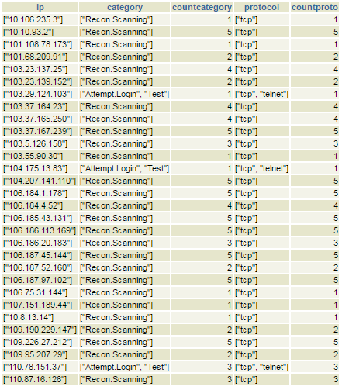

Slide 5
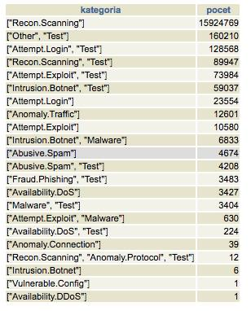
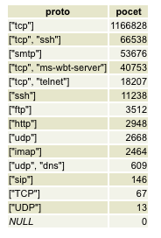

Slide 7
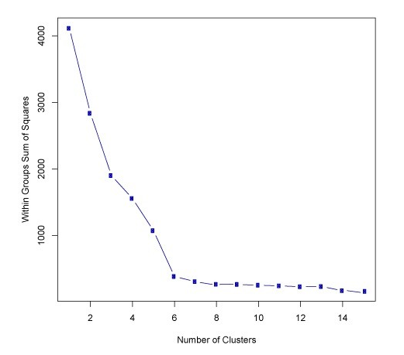
„Elbow“ metóda na určenie „k“ pre k-means

Slide 8
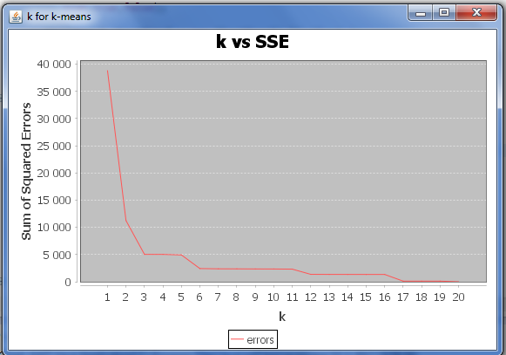

Slide 9
cluster0
[Anomaly.Traffic, (Itrusion.Botnet, Test)]
[UDP, TCP]
cluster1
[(Attempt.Exploit, Test)]
[FTP, SIP, http, IMAP]
cluster2
[(Attempt.Exploit, Test)]
[SMTP]
cluster3
[Recon.Scanning]
[TCP]
cluster4
[Anomaly.Traffic, Vulnerable.Config, (Recon.Scanning, Test), Recon.Scanning, Availability.DoS, (Attempt.Login, Test)]
[UDP, (udp, dns), (tcp, ms-wbt-server), (tcp, ssh), (tcp, telnet), TCP]
cluster5
[(Attempt.Exploit, Test)]
[SSH]

Slide 10
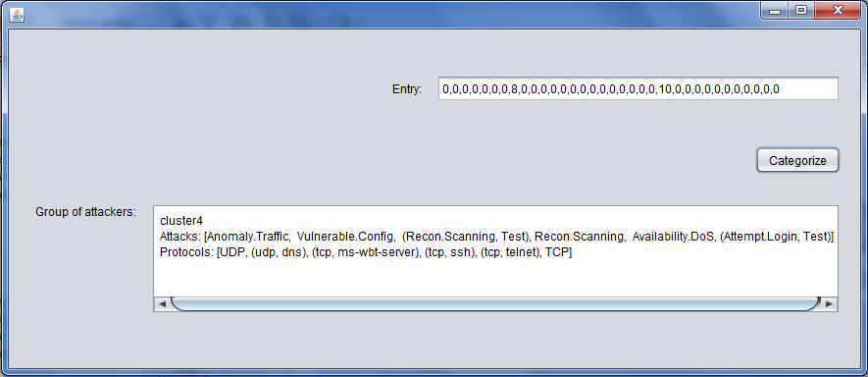
Zaradenie nového útočníka do skupiny

