Slide 1
Key distribution
Ján Kotrady

Slide 2
Content:
What is key distribution?
Key agreement and distribution
Basic algorithm – Diffie-Hellman
Basic attacks – Man in the middle
Advanced key distributions algorithms
    Needham-Schroder
    Bellare-Rogaway

Slide 3
What is key distribution ?
Cryptography
Session key distribution scheme
Key agreement
Authentication
Forward secrecy

Slide 4
Key agreement protocol
No trusted authority
Session keys
Without preceding shared secret
Diffie-Hellman - 1976

Slide 5



Diffie-Hellman - 1976
$\left(G,×\right), α ϵ G, ord\left(α\right)=n$
A
B
$$x ϵ {\text{ℤ}}_{n}$$
$$\text{y} ϵ {\text{ℤ}}_{n}$$

Slide 6


Diffie-Hellman - 1976
$\left(G,×\right), α ϵ G, ord\left(α\right)=n$
A
B
$$x ϵ {\text{ℤ}}_{n}$$
$$\text{y} ϵ {\text{ℤ}}_{n}$$
$$a=α^{x}$$

Slide 7

Diffie-Hellman - 1976
$\left(G,×\right), α ϵ G, ord\left(α\right)=n$
A
B
$$x ϵ {\text{ℤ}}_{n}$$
$$\text{y} ϵ {\text{ℤ}}_{n}$$
$$a=α^{x}$$
$$b=α^{y}$$

Slide 8



Diffie-Hellman – 1976
$\left(G,×\right), α ϵ G, ord\left(α\right)=n$
A
B
$$x ϵ {\text{ℤ}}_{n}$$
$$\text{y} ϵ {\text{ℤ}}_{n}$$
$$a=α^{x}$$
$$b=α^{y}$$
$K=b^{x}$ $=α^{xy}$
$$K=α^{xy}$$
$$K=a^{y}=α^{xy}$$

Slide 9

Diffie-Hellman – 1976
Man-in-the-middle attack
$\left(G,×\right), α ϵ G, ord\left(α\right)=n$
A
C
B
$$x ϵ {\text{ℤ}}_{n}$$
$$x′ ϵ {\text{ℤ}}_{n}$$
$$\text{y} ϵ {\text{ℤ}}_{n}$$

Slide 10

Diffie-Hellman – 1976
Man-in-the-middle attack
$\left(G,×\right), α ϵ G, ord\left(α\right)=n$
A
C
B
$$x ϵ {\text{ℤ}}_{n}$$
$$x′ ϵ {\text{ℤ}}_{n}$$
$$\text{y} ϵ {\text{ℤ}}_{n}$$
$$a=α^{x}$$

Slide 11

Diffie-Hellman – 1976
Man-in-the-middle attack
$\left(G,×\right), α ϵ G, ord\left(α\right)=n$
A
C
B
$$x ϵ {\text{ℤ}}_{n}$$
$$x′ ϵ {\text{ℤ}}_{n}$$
$$\text{y} ϵ {\text{ℤ}}_{n}$$
$$a=α^{x}$$
$$a′=α^{x′}$$

Slide 12

Diffie-Hellman – 1976
Man-in-the-middle attack
$\left(G,×\right), α ϵ G, ord\left(α\right)=n$
A
C
B
$$x ϵ {\text{ℤ}}_{n}$$
$$x′ ϵ {\text{ℤ}}_{n}$$
$$\text{y} ϵ {\text{ℤ}}_{n}$$
$$a=α^{x}$$
$$a′=α^{x′}$$
$$b=α^{y}$$

Slide 13
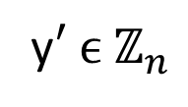

Diffie-Hellman – 1976
Man-in-the-middle attack
$\left(G,×\right), α ϵ G, ord\left(α\right)=n$
A
C
B
$$x ϵ {\text{ℤ}}_{n}$$
$$x′ ϵ {\text{ℤ}}_{n}$$
$$\text{y} ϵ {\text{ℤ}}_{n}$$
$$a=α^{x}$$
$$a′=α^{x′}$$
y$′ ϵ {\text{ℤ}}_{n}$
$$b′=α^{y′}$$
$$b=α^{y}$$

Slide 14




Diffie-Hellman – 1976
Man-in-the-middle attack
$\left(G,×\right), α ϵ G, ord\left(α\right)=n$
A
C
B
$$x ϵ {\text{ℤ}}_{n}$$
$$x′ ϵ {\text{ℤ}}_{n}$$
$$\text{y} ϵ {\text{ℤ}}_{n}$$
$$a=α^{x}$$
$$a′=α^{x′}$$
y$′ ϵ {\text{ℤ}}_{n}$
$$b′=α^{y′}$$
$$b=α^{y}$$
$$K=α^{xy′}$$
$$K_{A}=α^{xy′}$$
$$K_{B}=α^{x′y}$$
$$K=α^{x′y}$$

Slide 15
Key distribution
Trusted authority (TA)
A have secret key with TA
Also B have secret key with TA
TA provide certificates for all users
Symmetric cryptography

Slide 16
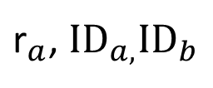
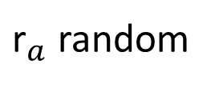
Heedham-Schroeder – 1978
TA
A
B
${\text{r}}_{a}$, ${\text{ID}}_{a,}{\text{ID}}_{b}$
${\text{r}}_{a}$ random

Slide 17

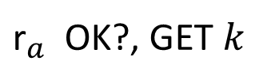



Heedham-Schroeder – 1978
TA
$${\text{t}}_{b}={\text{e}}_{Kb}(k,{ID}_{a})$$
A
B
$$k random$$
${\text{r}}_{a}$, ${\text{ID}}_{a,}{\text{ID}}_{b}$
${\text{r}}_{a}$ random
$${\text{d}}_{Ka}({\text{y}}_{1})$$
$${\text{y}}_{1}={\text{e}}_{Ka}({\text{r}}_{a},k,{\text{t}}_{b},{ID}_{b})$$
${\text{r}}_{a}$ OK?, GET $k$

Slide 18

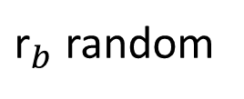

Heedham-Schroeder – 1978
TA
$${\text{t}}_{b}={\text{e}}_{Kb}(k,{ID}_{a})$$
A
B
$$k random$$
${\text{r}}_{a}$, ${\text{ID}}_{a,}{\text{ID}}_{b}$
${\text{r}}_{a}$ random
$${\text{d}}_{Ka}({\text{y}}_{1})$$
$${\text{y}}_{1}={\text{e}}_{Ka}({\text{r}}_{a},k,{\text{t}}_{b},{ID}_{b})$$
${\text{r}}_{a}$ OK?, GET $k$
$${\text{t}}_{b}$$
$${\text{y}}_{2}={\text{e}}_{k}({\text{r}}_{b})$$
${\text{r}}_{b}$ random

Slide 19

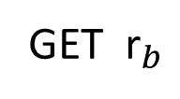


Heedham-Schroeder – 1978
TA
$${\text{t}}_{b}={\text{e}}_{Kb}(k,{ID}_{a})$$
A
B
$$k random$$
${\text{r}}_{a}$, ${\text{ID}}_{a,}{\text{ID}}_{b}$
${\text{r}}_{a}$ random
$${\text{d}}_{Ka}({\text{y}}_{1})$$
$${\text{y}}_{1}={\text{e}}_{Ka}({\text{r}}_{a},k,{\text{t}}_{b},{ID}_{b})$$
${\text{r}}_{a}$ OK?, GET $k$
$${\text{t}}_{b}$$
GET ${\text{r}}_{b}$
$${\text{y}}_{2}={\text{e}}_{k}({\text{r}}_{b})$$
${\text{r}}_{b}$ random
$${\text{y}}_{3}={\text{e}}_{k}({\text{r}}_{b}−1)$$
$${\text{y}}_{3}$$
$$OK?ACK!$$

Slide 20



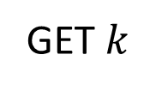
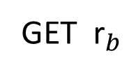

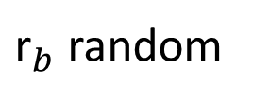

Heedham-Schroeder – 1978
C
B
GET $k$
$${\text{t}}_{b}$$
GET ${\text{r}}_{b}$
$${\text{y}}_{2}={\text{e}}_{k}({\text{r}}_{b})$$
${\text{r}}_{b}$ random
$${\text{y}}_{3}={\text{e}}_{k}({\text{r}}_{b}−1)$$
$${\text{y}}_{3}$$
$$OK?ACK!$$

Slide 21
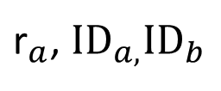
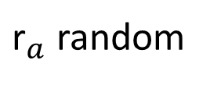
Bellare-Rogaway
TA
B
A
${\text{r}}_{a}$, ${\text{ID}}_{a,}{\text{ID}}_{b}$
${\text{r}}_{a}$ random

Slide 22
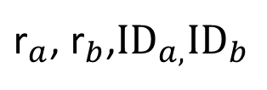
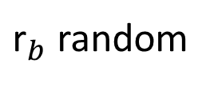
Bellare-Rogaway
TA
B
A
${\text{r}}_{a}$, ${\text{r}}_{b}$,${\text{ID}}_{a,}{\text{ID}}_{b}$
${\text{r}}_{b}$ random
${\text{r}}_{a}$ random
${\text{r}}_{a}$, ${\text{ID}}_{a,}{\text{ID}}_{b}$

Slide 23
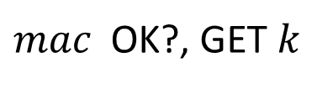


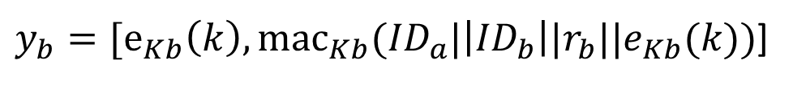

Bellare-Rogaway
TA
$y_{b}=[{\text{e}}_{Kb}\left(k\right),{\text{mac}}_{Kb}({ID}_{a}|\left|{ID}_{b}\right||r_{b}||e_{Kb}(k))$]
B
A
$$k random$$
${\text{r}}_{a}$, ${\text{r}}_{b}$,${\text{ID}}_{a,}{\text{ID}}_{b}$
${\text{r}}_{b}$ random
${\text{r}}_{a}$ random
${\text{r}}_{a}$, ${\text{ID}}_{a,}{\text{ID}}_{b}$
$${\text{d}}_{Kb}({\text{y}}_{b})$$
$$y_{b}$$
$mac$ OK?, GET $k$

Slide 24
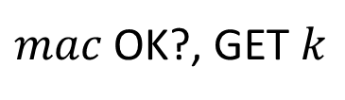

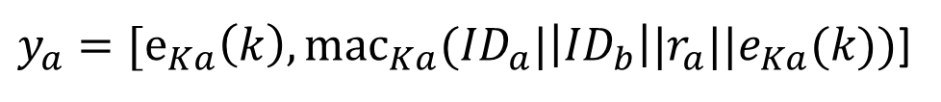

Bellare-Rogaway
TA
$y_{b}=[{\text{e}}_{Kb}\left(k\right),{\text{mac}}_{Kb}({ID}_{a}|\left|{ID}_{b}\right||r_{b}||e_{Kb}(k))$]
B
A
$$k random$$
${\text{r}}_{a}$, ${\text{r}}_{b}$,${\text{ID}}_{a,}{\text{ID}}_{b}$
${\text{r}}_{b}$ random
${\text{r}}_{a}$ random
${\text{r}}_{a}$, ${\text{ID}}_{a,}{\text{ID}}_{b}$
$${\text{d}}_{Kb}({\text{y}}_{b})$$
$$y_{b}$$
$mac$ OK?, GET $k$
$${\text{d}}_{Ka}({\text{y}}_{a})$$
$y_{a}=[{\text{e}}_{Ka}\left(k\right),{\text{mac}}_{Ka}({ID}_{a}|\left|{ID}_{b}\right||r_{a}||e_{Ka}(k))$]
$mac$ OK?, GET $k$
$$OK?ACK!$$

Slide 25
Summary:
Diffie-Hellman – easy man in the middle
Heedham-Schroeder – no forward secrecy
Bellare-Rogaway – TA loading

Slide 26
Sources:
http://en.wikipedia.org/wiki/Diffie%E2%80%93Hellman_key_exchange
Stinson: Cryptography - Theory and Practice
Menezes, Oorschot, Vanstone - HANDBOOK of APPLIED CRYPTOGRAPHY

Slide 27
Thank the audience for their attention and invite questions.

